Slide 1
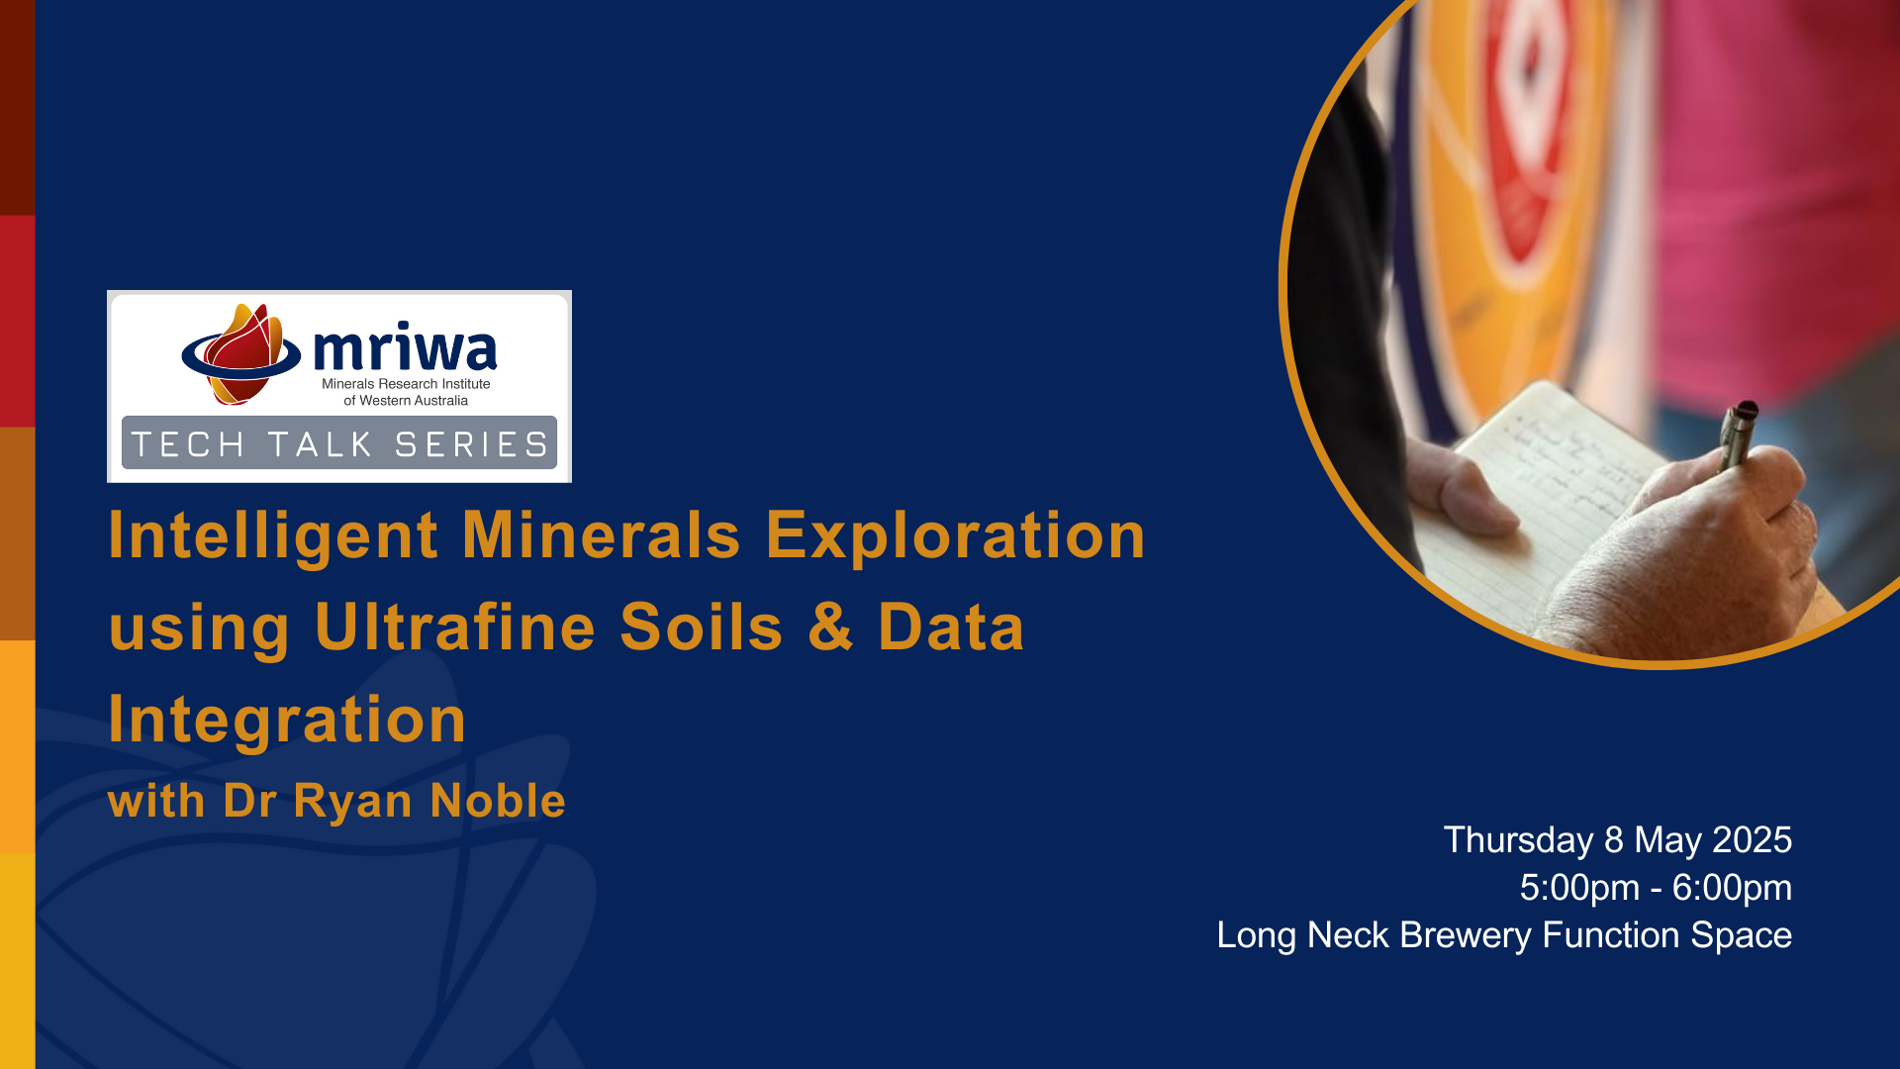

Slide 2
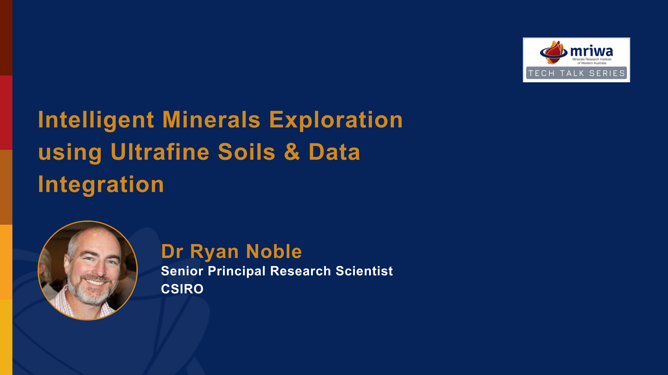

Slide 3

Intelligent mineral exploration using ultrafine soils and data integration
Ryan Noble (on behalf of the UltraFine+® Team)
May 2025
Notes:
About
MRIWA invites you to our monthly tech talks discussing the intricate processes and findings of our recently completed projects with a chance to question the researchers face to face.
In a geochemical approach to provide more efficient and effective exploration decision making across the vast areas of WA where prospective geology is covered by later sediments, Dr Ryan Noble and his team at CSIRO were funded from 2020 - 2023 to develop a robust set of measurable parameters and new data products using the UltraFine+TM method.
Aiming to support the discovery of the next generation of ore deposits, and to assess the relationship of geochemistry to soil properties including spectral mineralogy and pH, the team at CSIRO applied publicly available data to machine learning helping to identify next-generation exploration targets, explain and filter out false positive results, and quantify uncertainty in soil geochemistry results to better assess risk and support qualified exploration decisions
Date
Thursday 8 May 2025 5:00 PM - 6:00 PM (UTC+08)
Long Neck Brewery Private Function Room
306 Riverside Drive, East Perth WA 60004

Slide 4
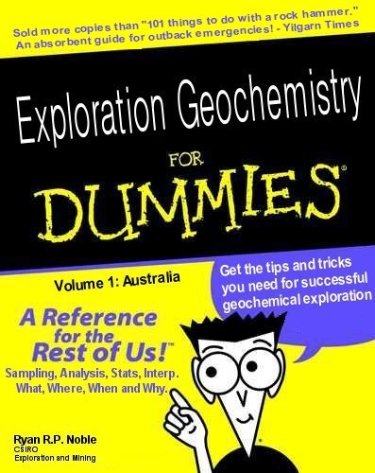
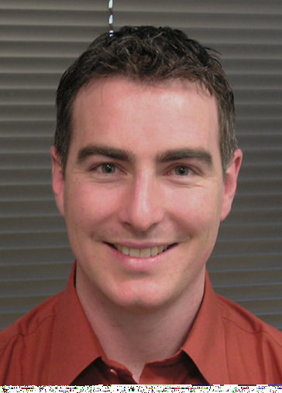
2005
Notes:
What are the questions that you first looked at and why? Landscape context, soil variation and morphology etc.

Slide 5
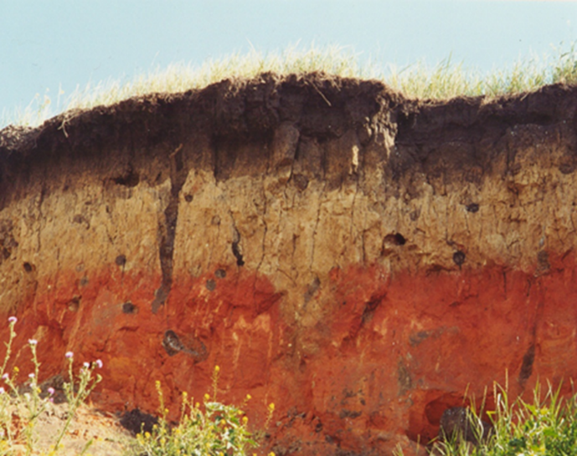
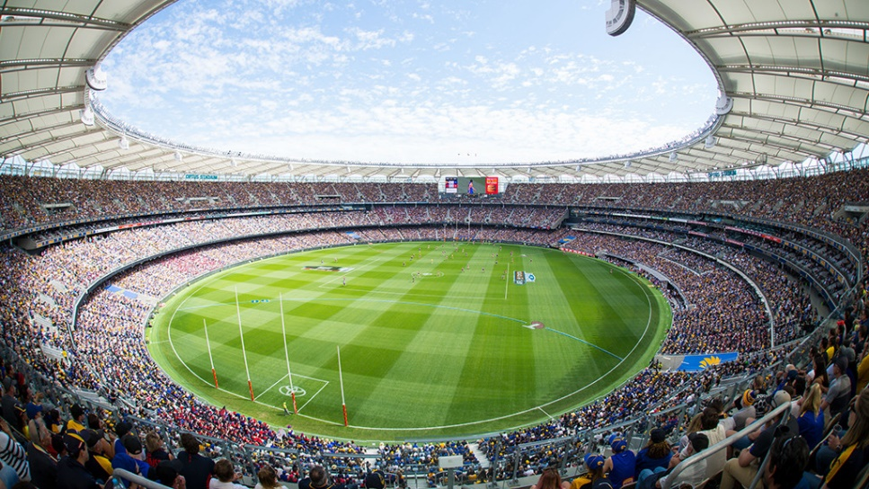
Notes:
Talk about my history of understanding soil morphology – how do we incorporate that into exploration.
Also shows a great example where sampling a krotivina would give different results or an eroded slope would give a very different soil sample.
Leads to next slide about working with the best fit for purpose method and how it develops

Slide 6
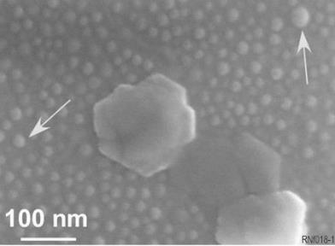
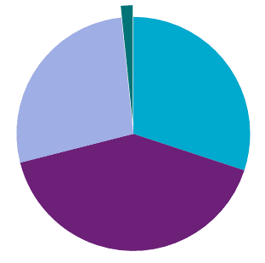

2012
53 µm
-
2 µm
<0.2 µm
Mineral | Diameter (µm) | Surface area (m²/g)
Sand | 50-2000 | 0.04
Silt | 2-50 | 0.1
CLAYS (fine fractions) | < 2 | 5 – 800
2 µm - 0.2 µm
n=14
Notes:
Why are we mainly sampling this sand?

Slide 7
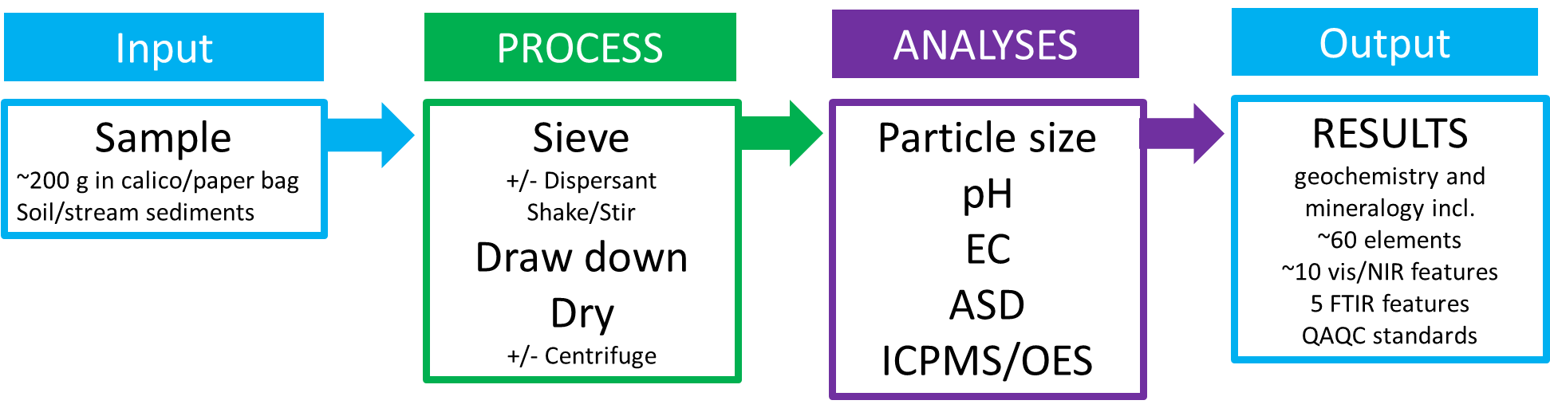
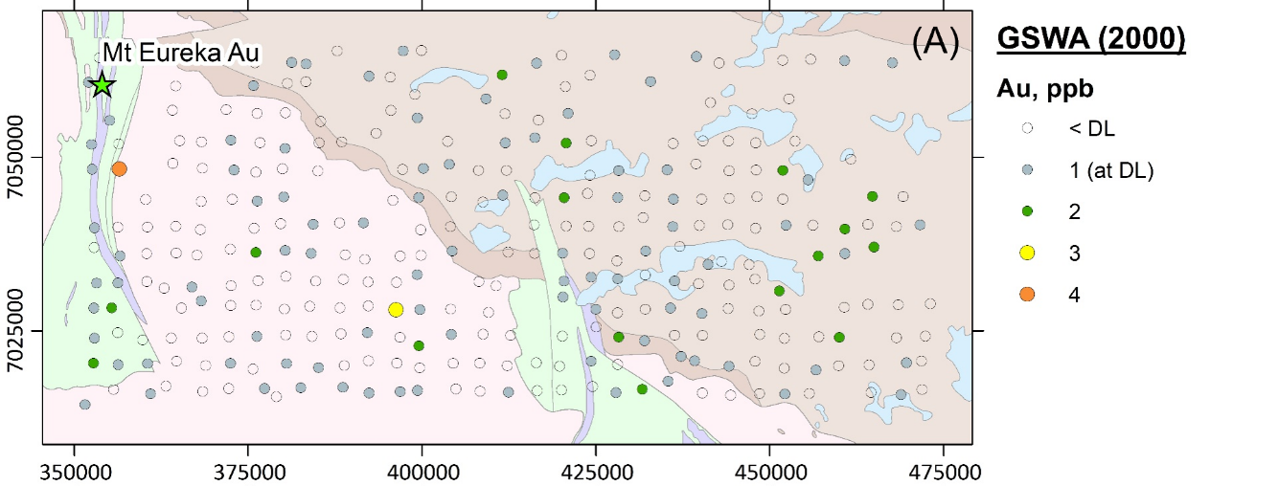
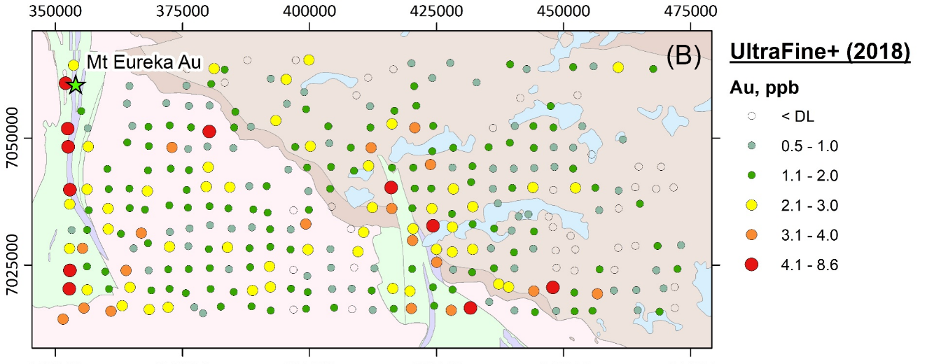
2018
Outcomes = ↑ 250% Au and pathfinder elements, ↓ bdl especially for Au
added Pd and Pt and ok for REE and resistates
Notes:
M462 Initial project = Method dev and commercialisation
= 5 researchers, 1 report and 2 papers, a commercially available method

Slide 8
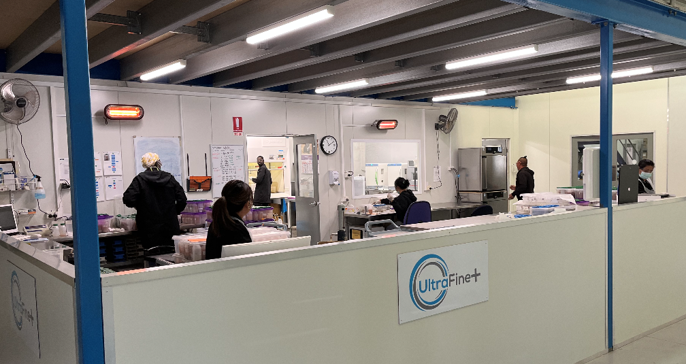

Notes:
M462 Initial project = Method dev and commercialisation
= 5 researchers, 1 report and 2 papers, a commercially available method

Slide 9
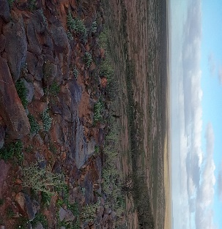
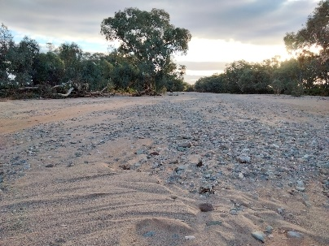
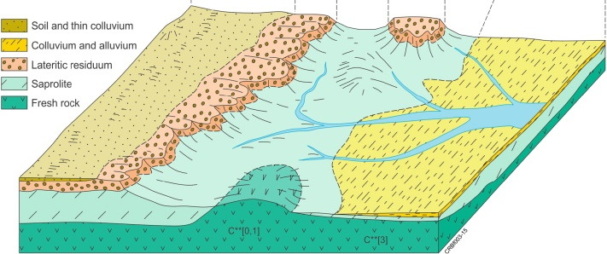
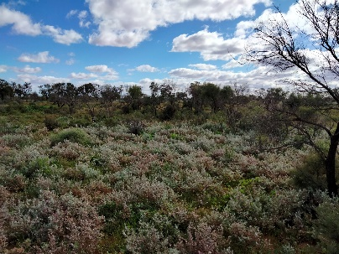





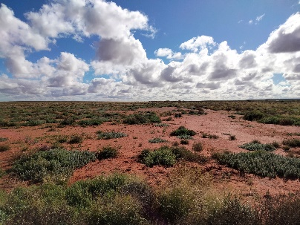

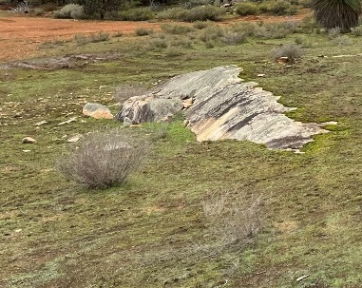
2020 - why we need landscape context?
Modified after Butt et al. 2016
Notes:
The next project was to put that data in landscape context and make it easy to interpret…
M462a = Next Gen Analytics: Providing soil context with ML
12 researchers, 3 student projects, 4 reports, 4+ papers, website, FAQ, guidelines,
>40 of models, and more…

Slide 10
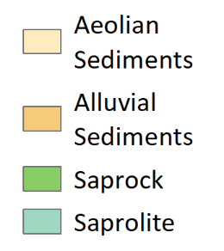
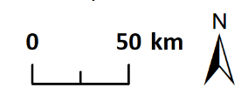
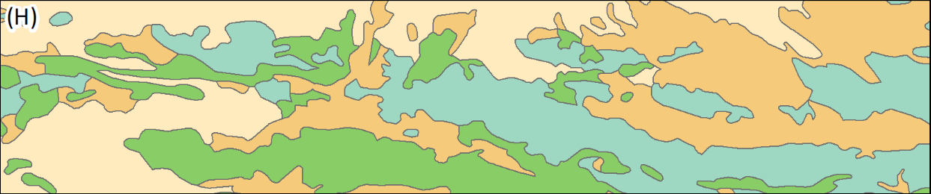
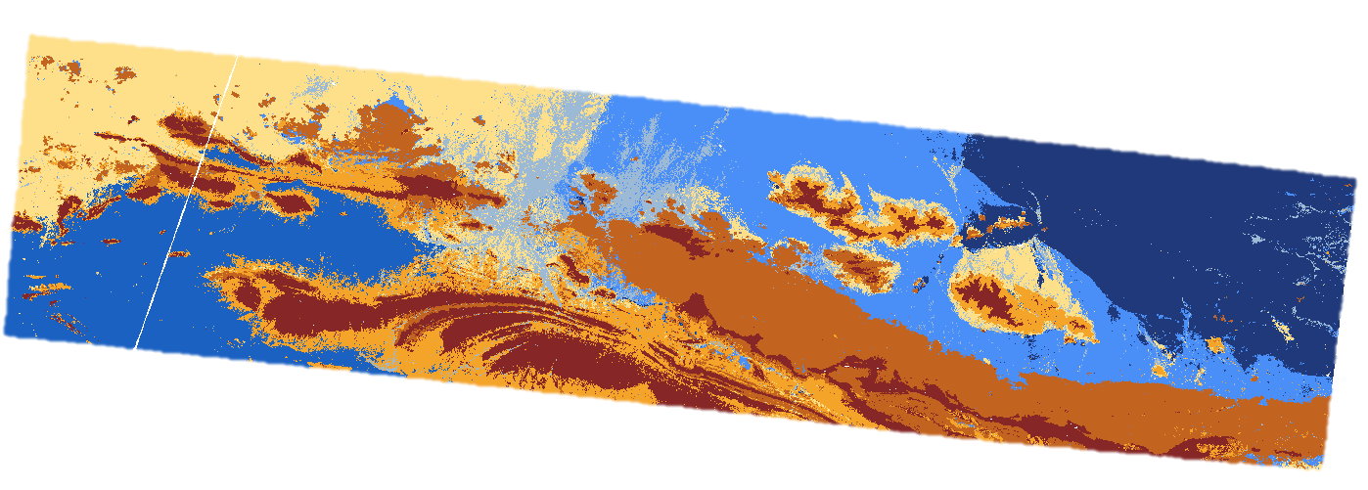

Slide 12
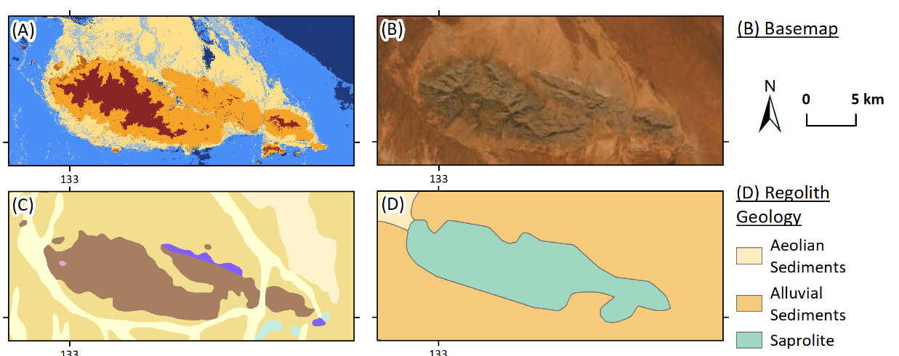
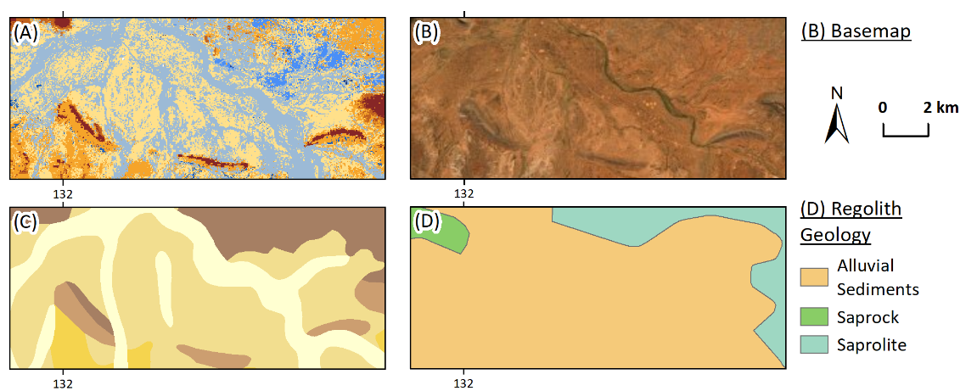
Erosional landscapes
Depositional Landscapes

Slide 13
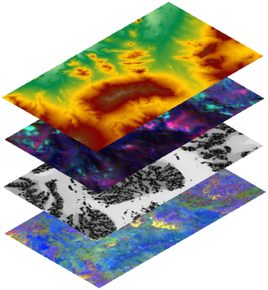
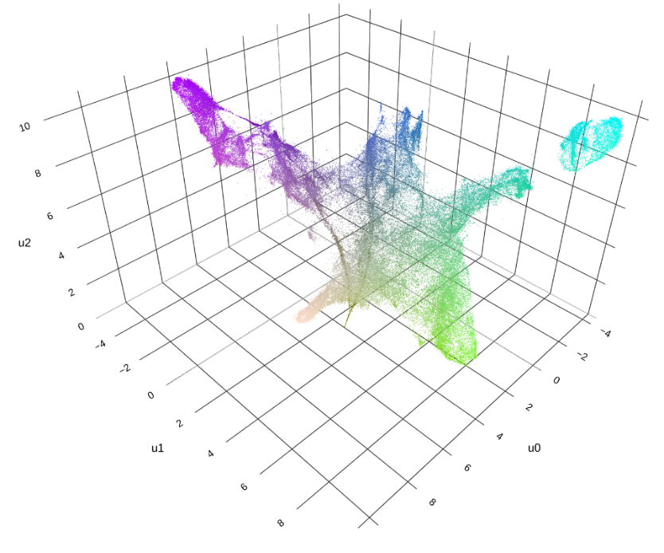
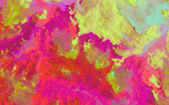
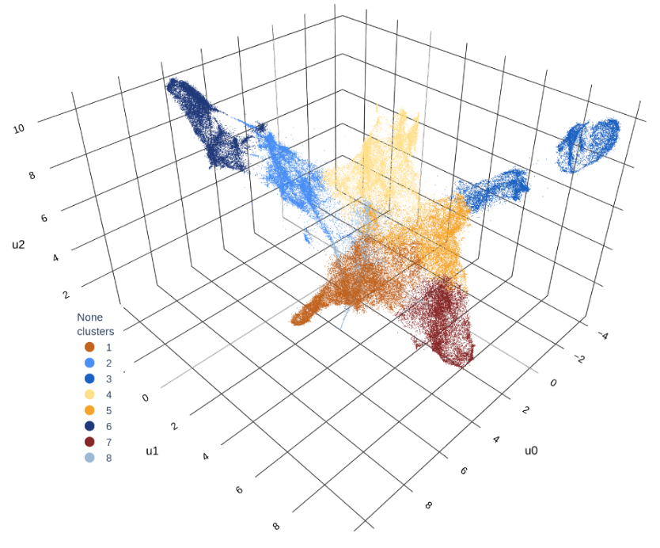
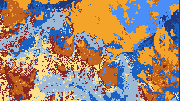
Make better maps
DEM (Landscape position)
Radiometrics (Parent/provenance material)
MrVBF (Depth of transported cover)
Sentinel-2 (Regolith materials)
UMAP (Feature similarity map)
Clustering (Proxy landscape types map)

Slide 14
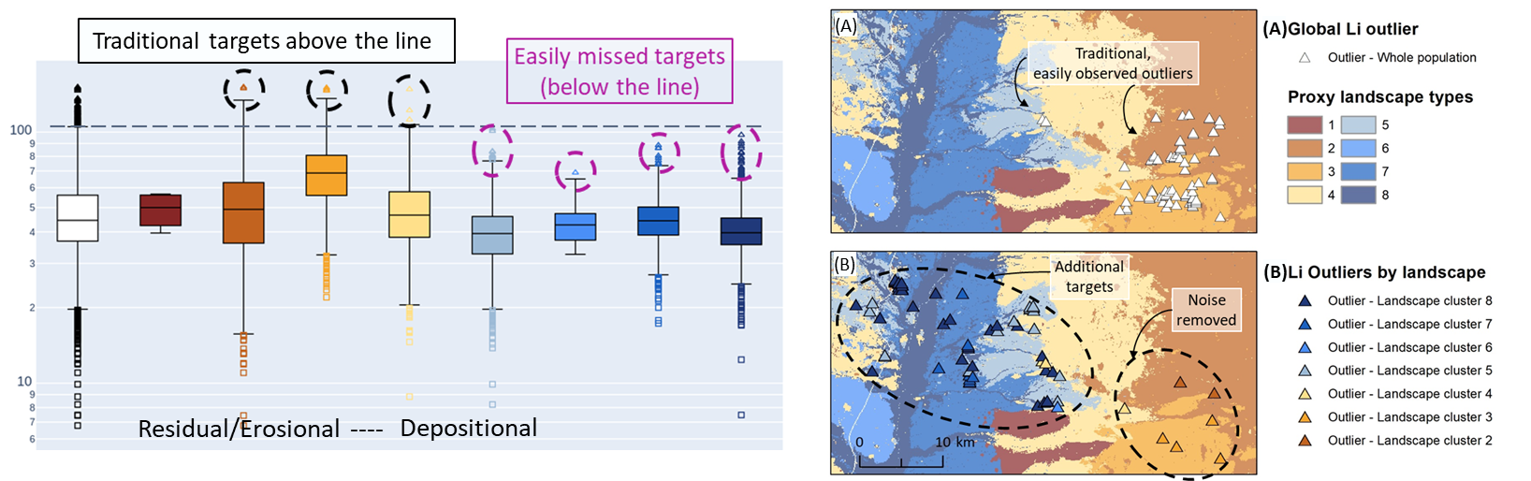
Adding back in the chemistry
Notes:
Adding back in the chemistry from the ultrafine results

Slide 15
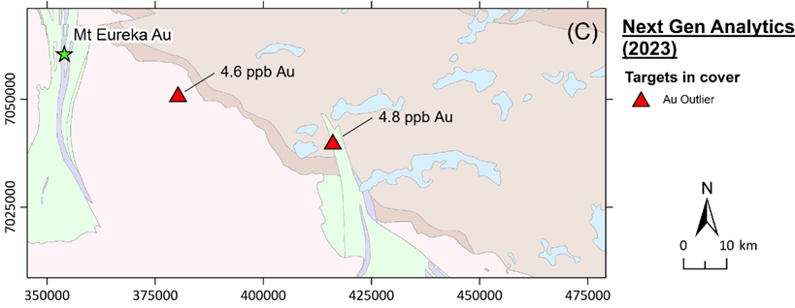
2023 - M462a ends

Slide 16
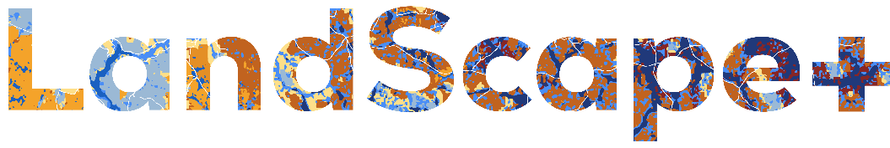
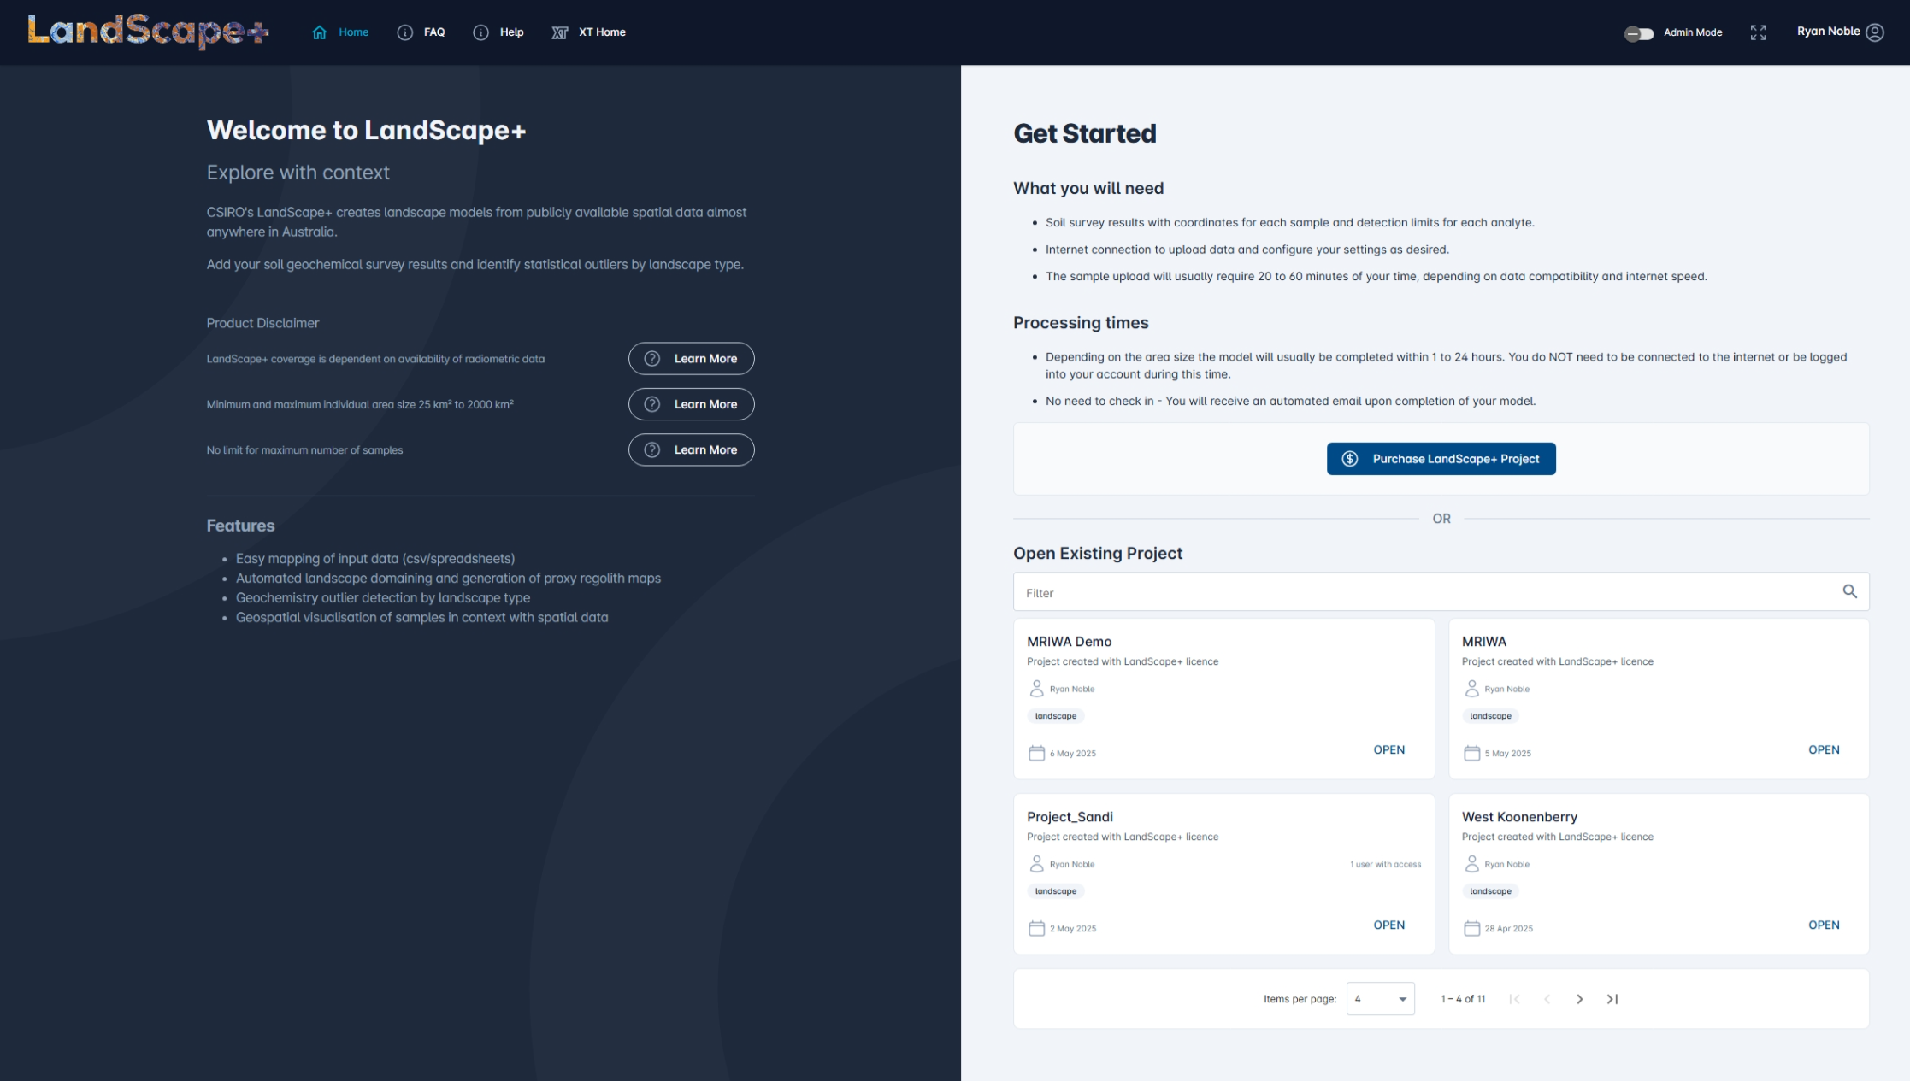

2025 – release
Anicia Henne
Full demonstration
AMEC events (June)

Slide 17
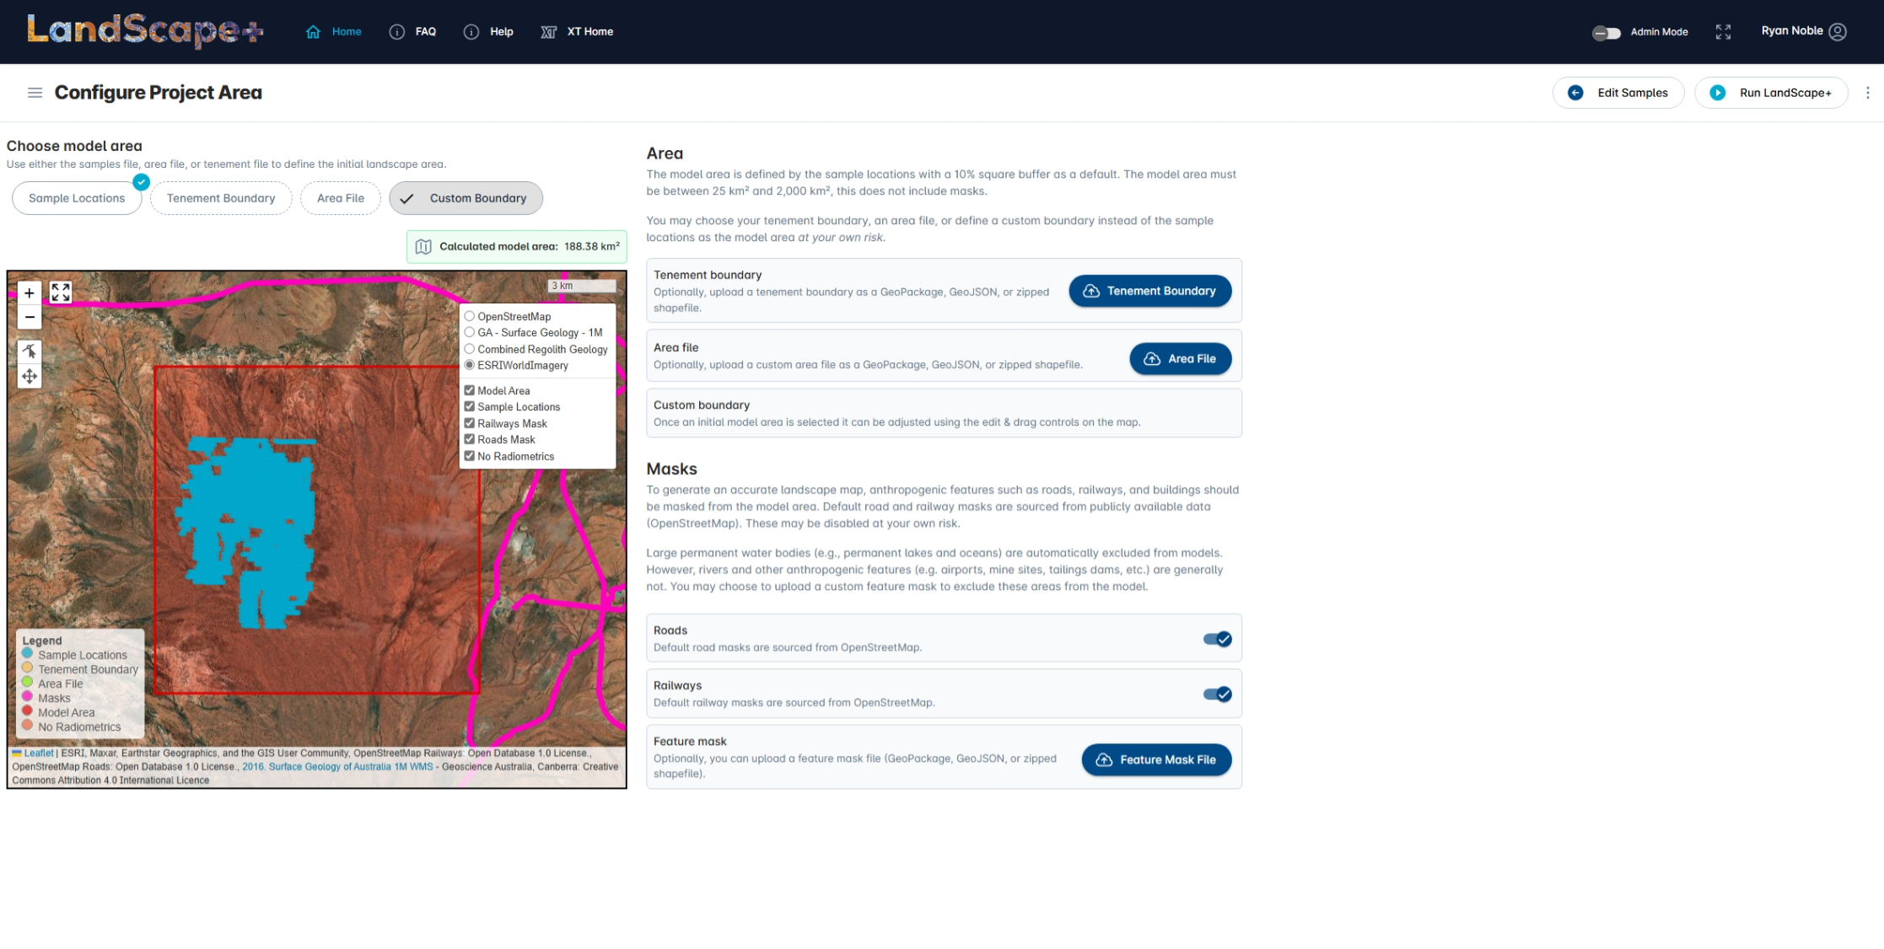
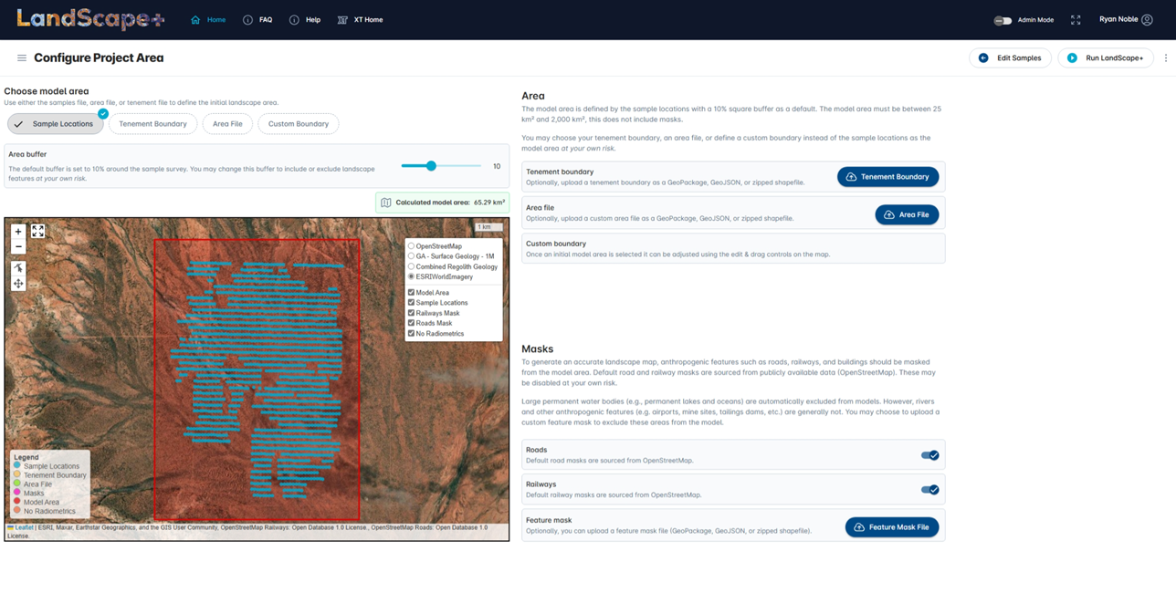
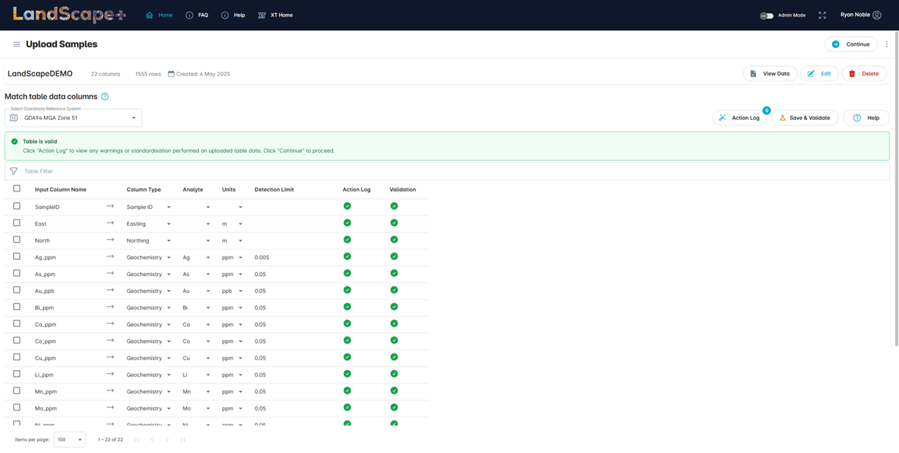
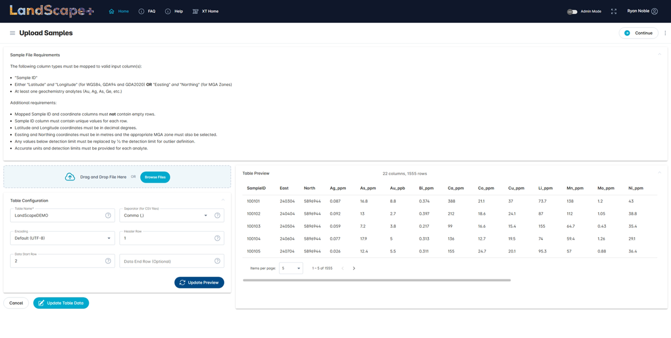
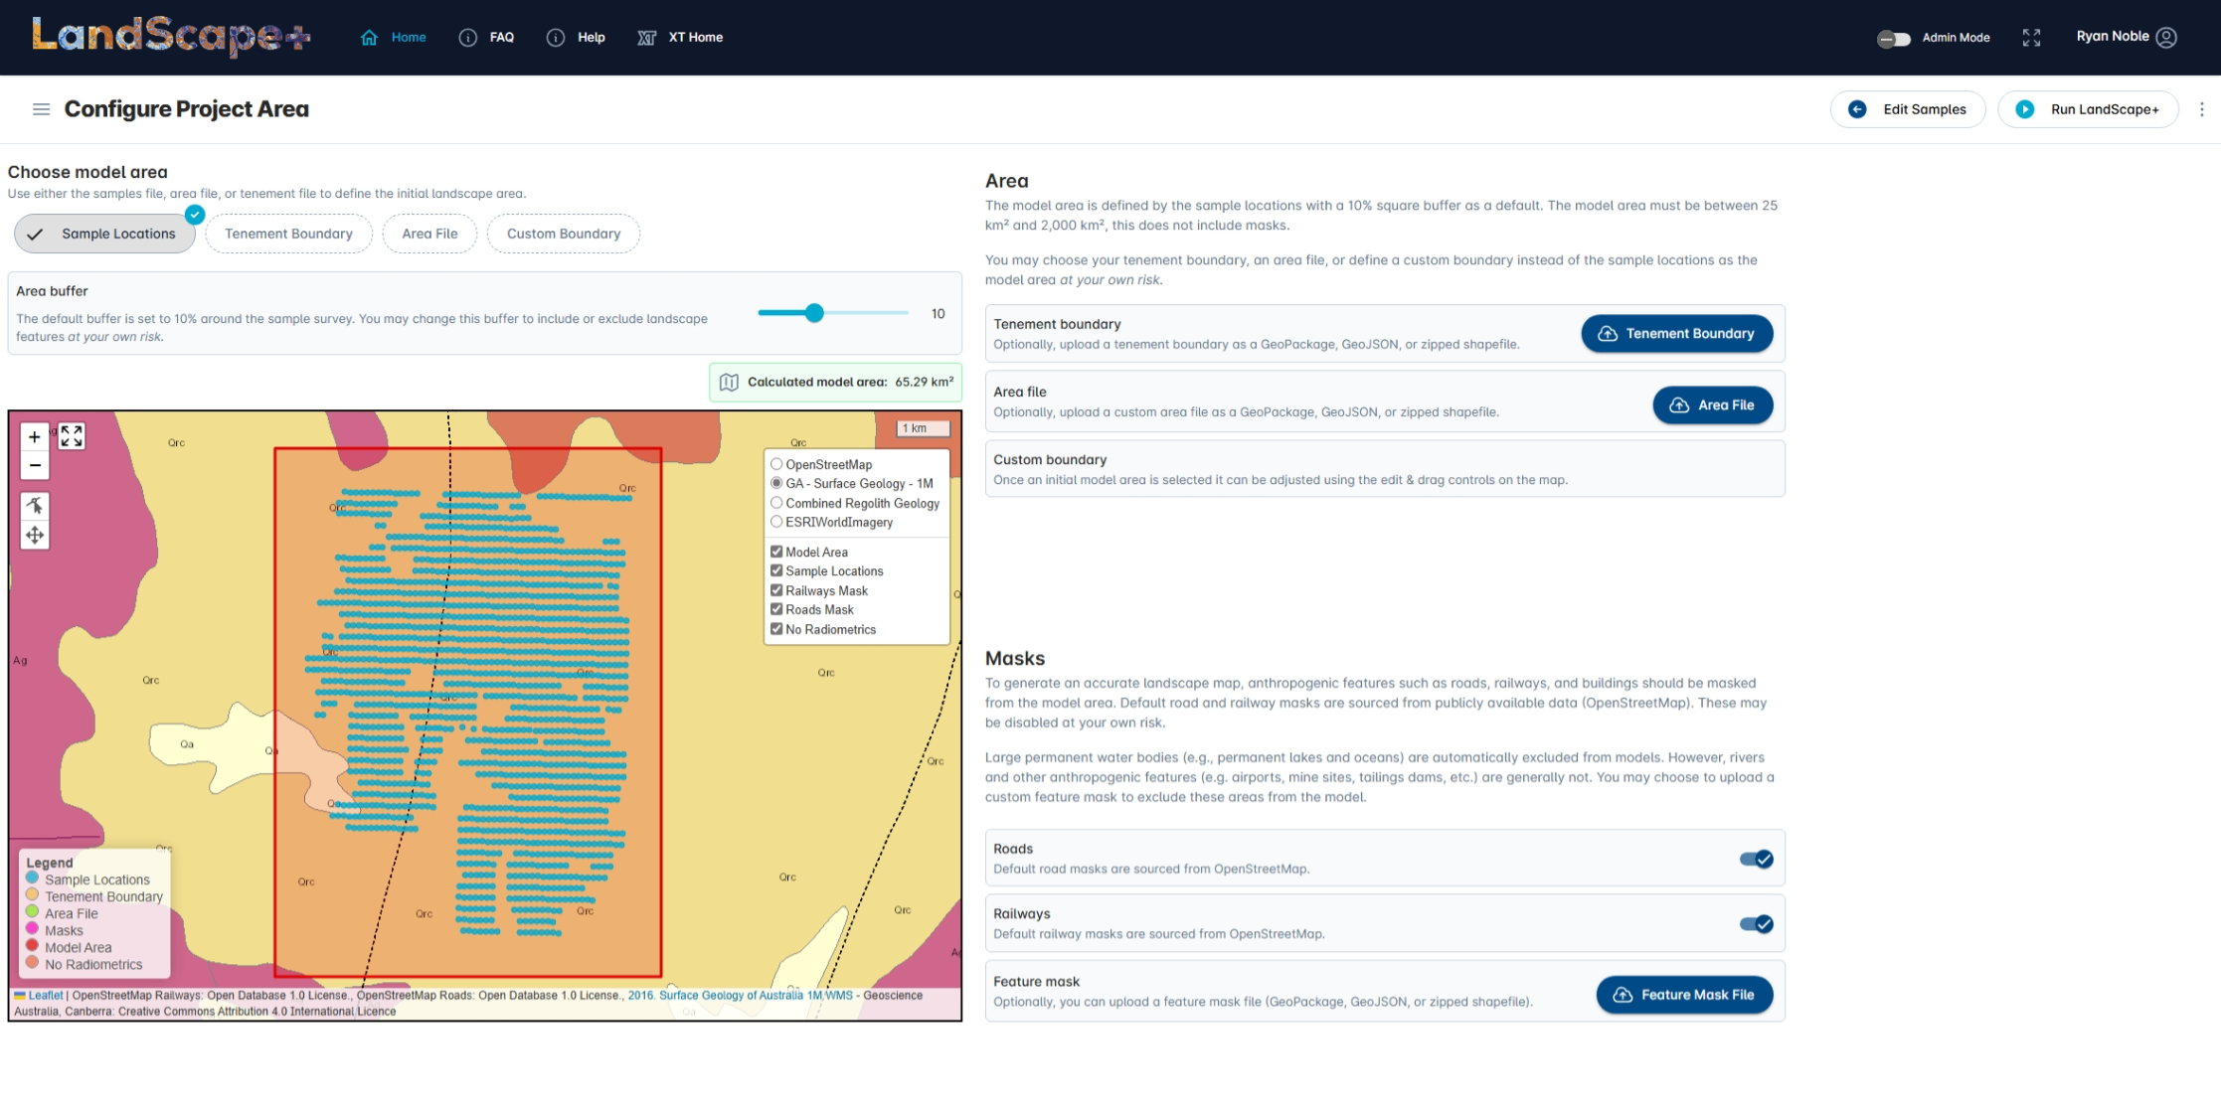
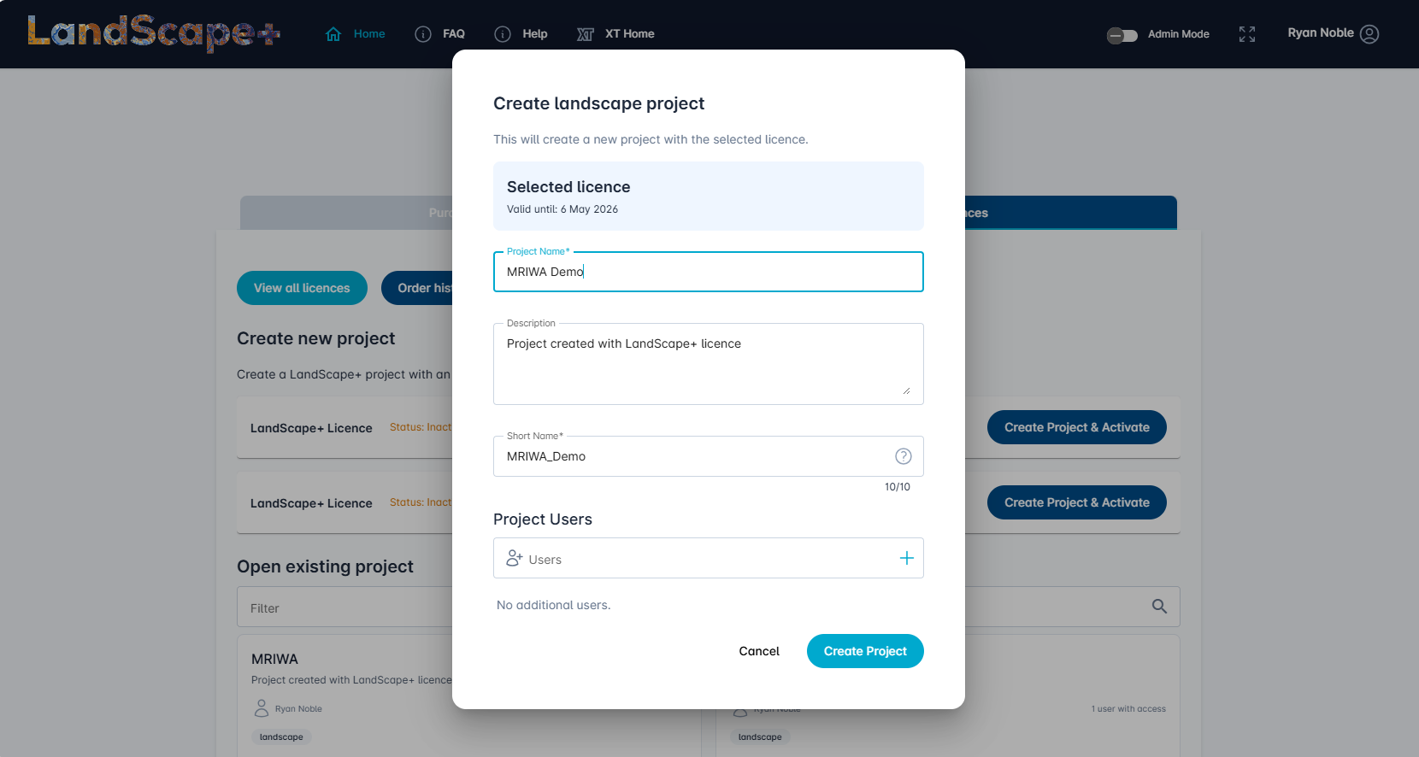
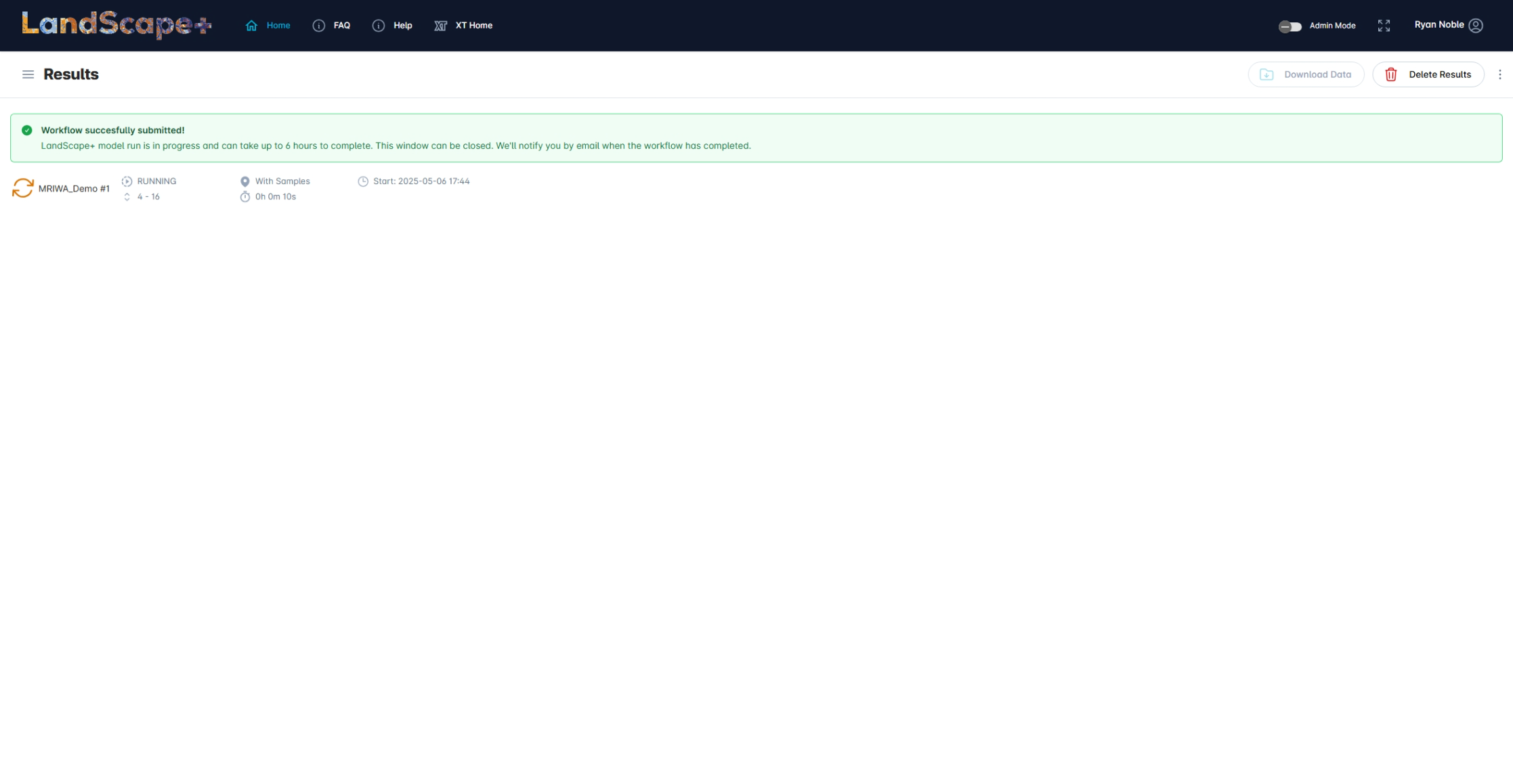

Slide 18
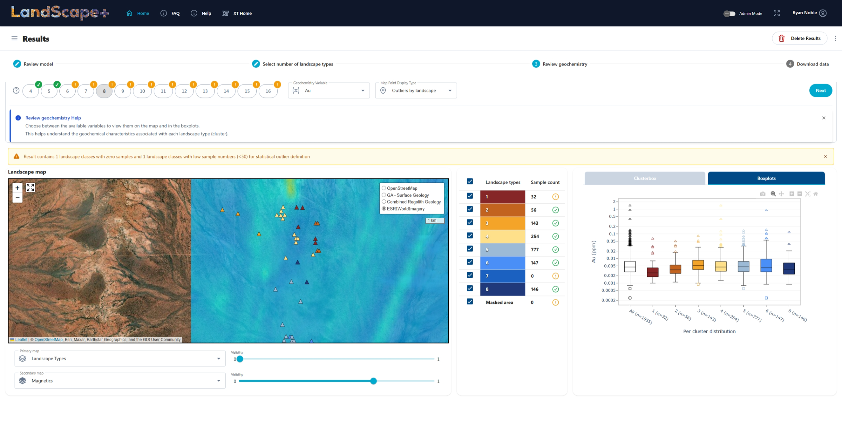
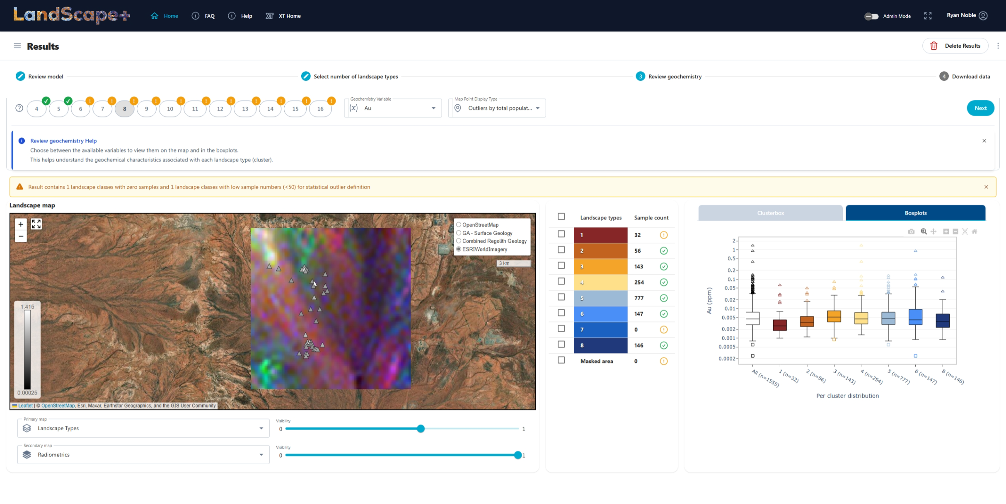
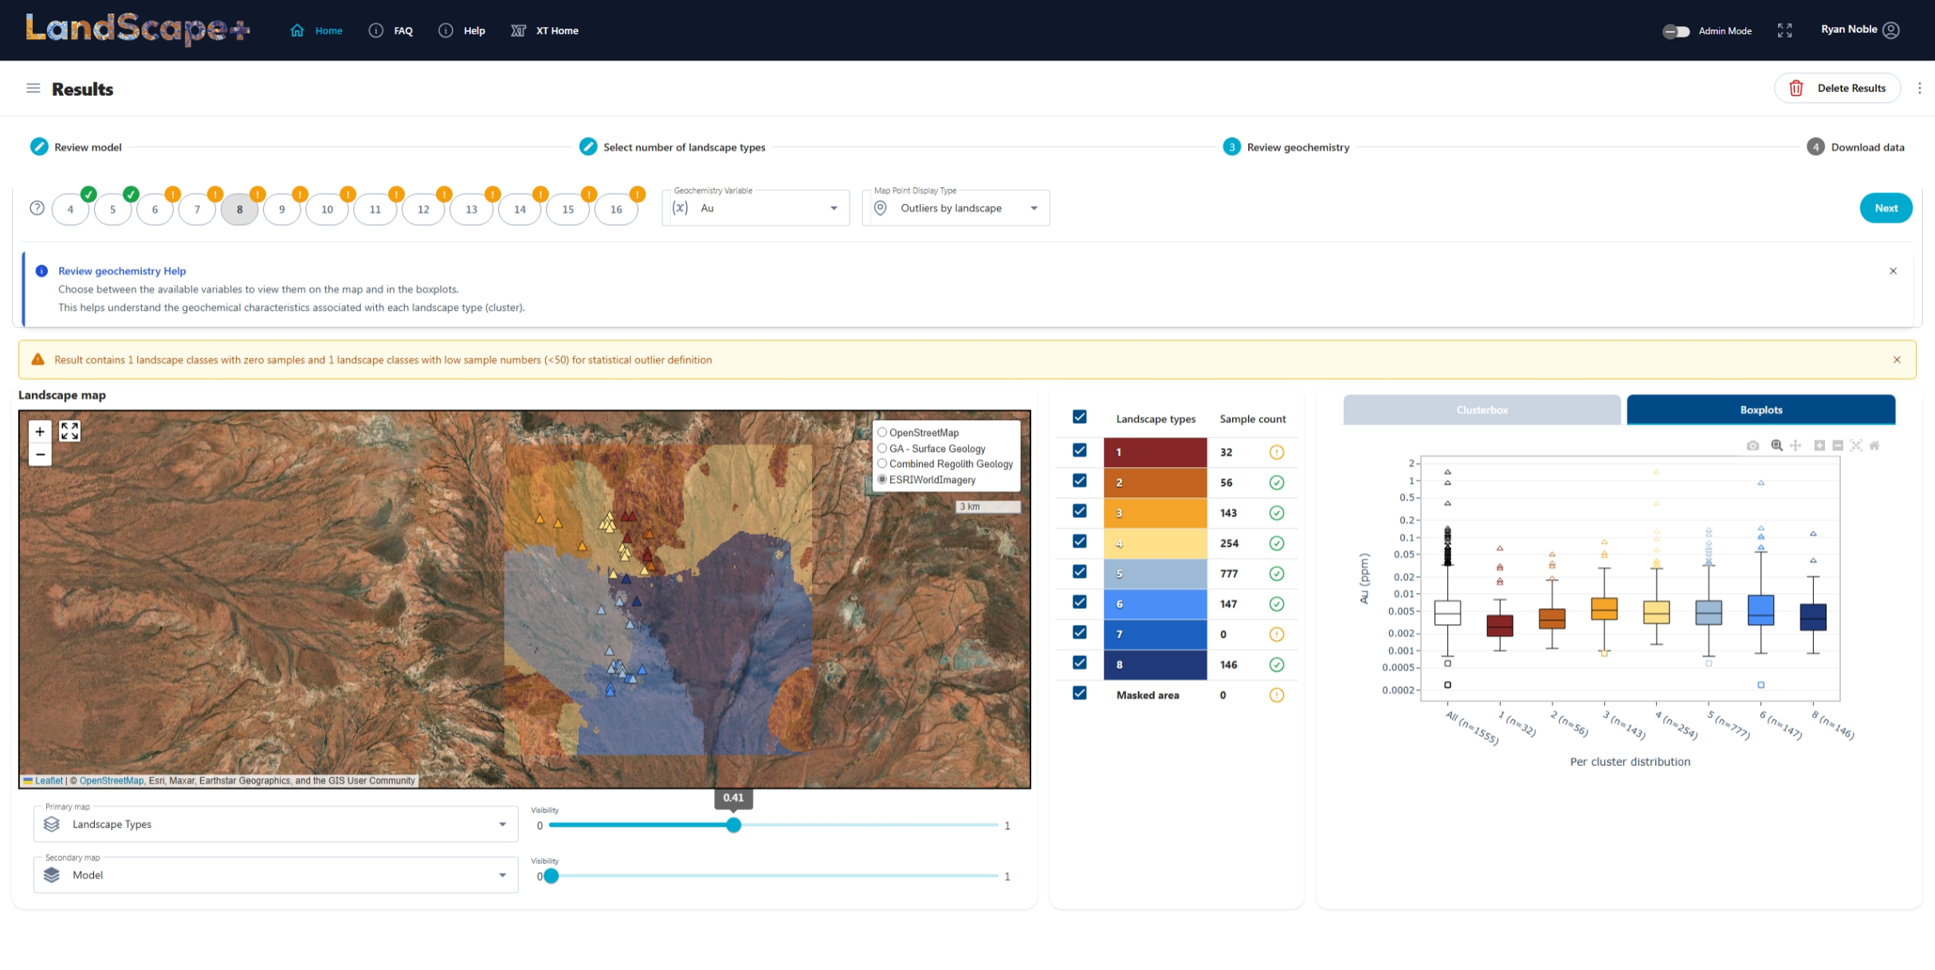
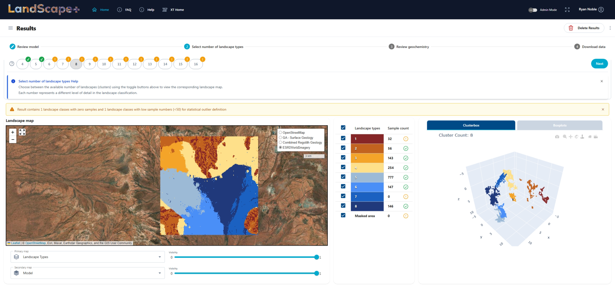
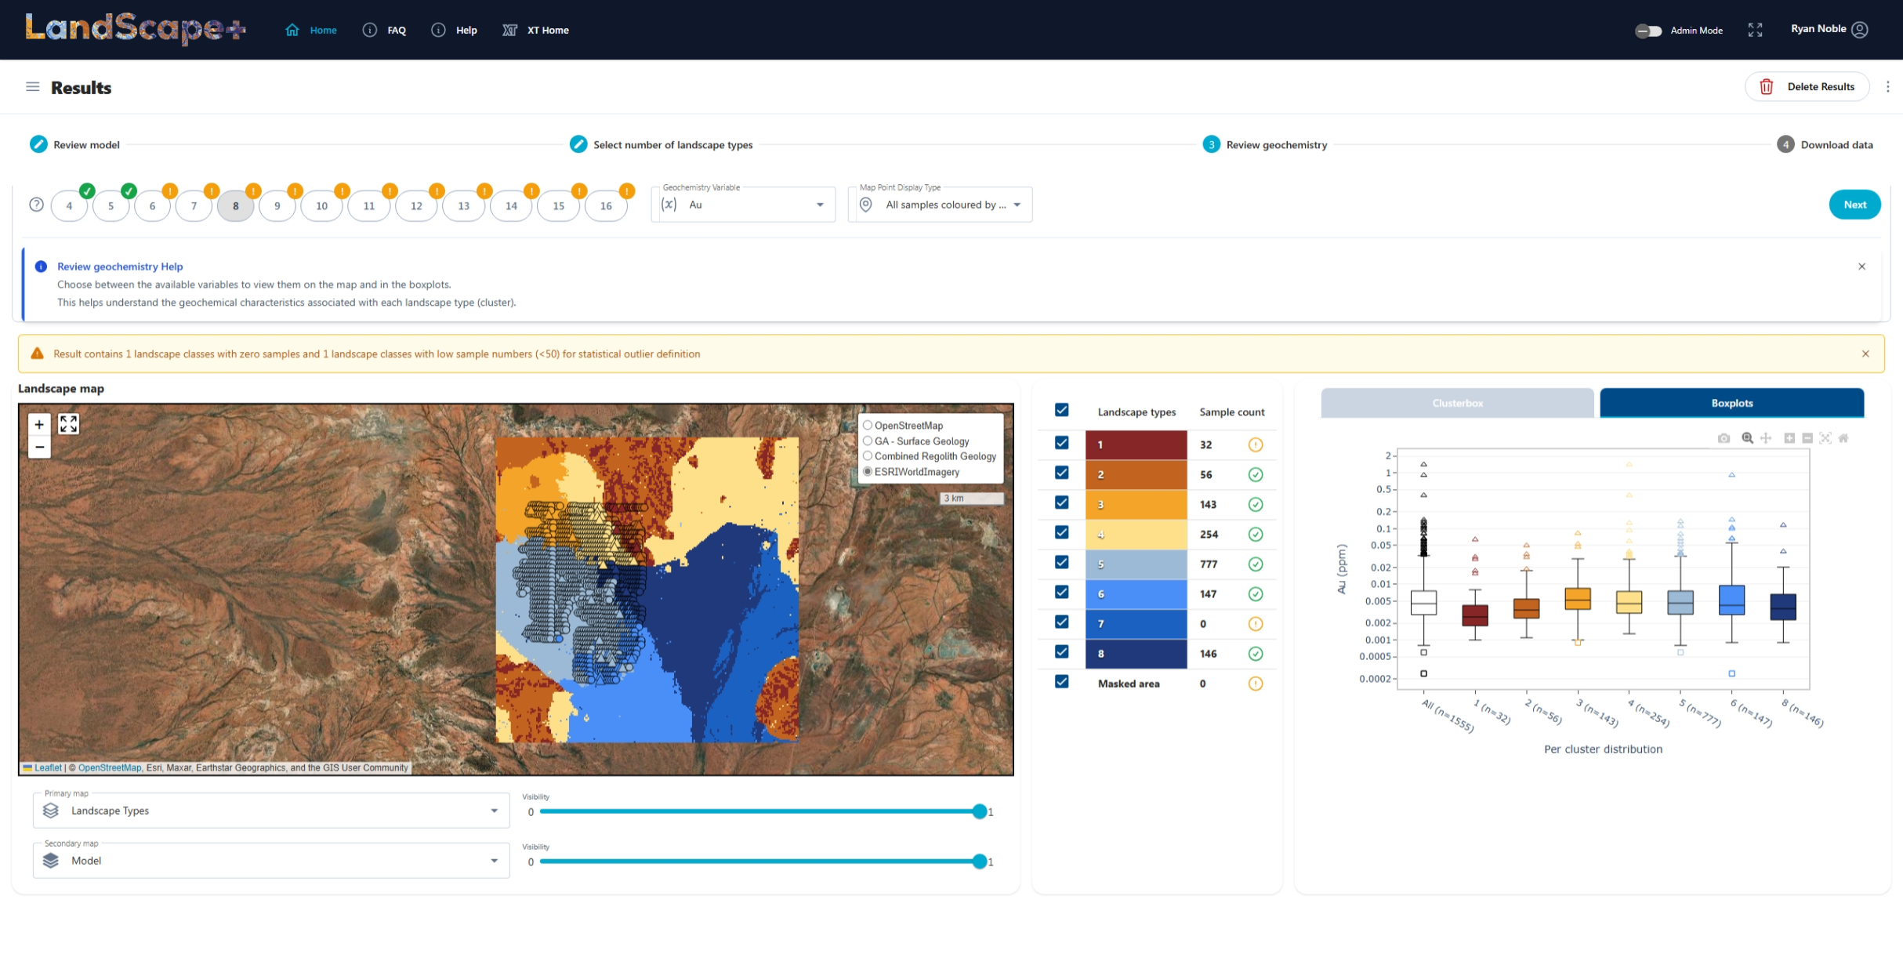
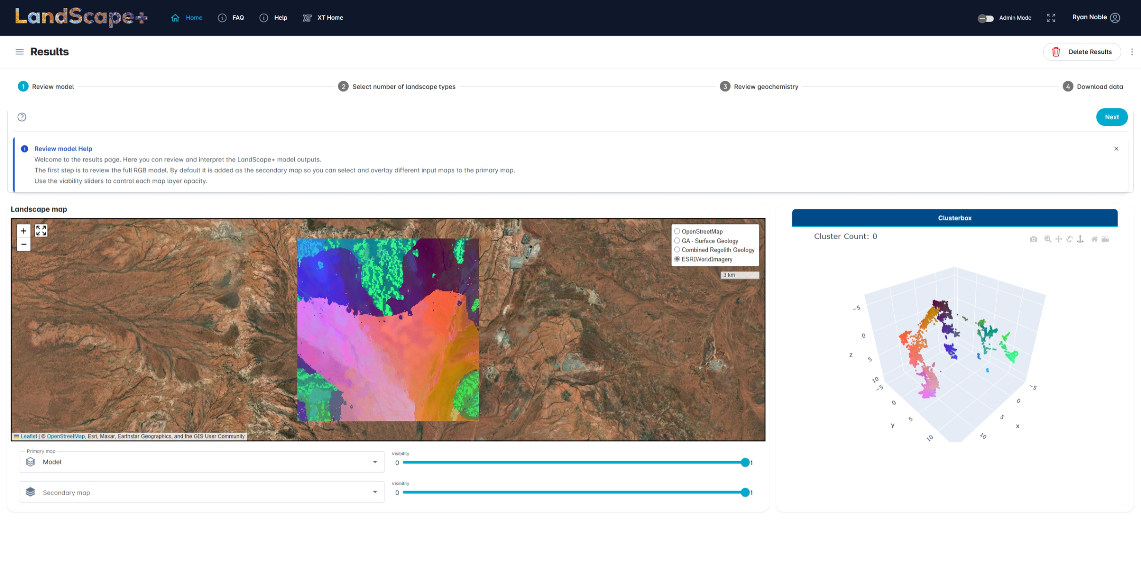
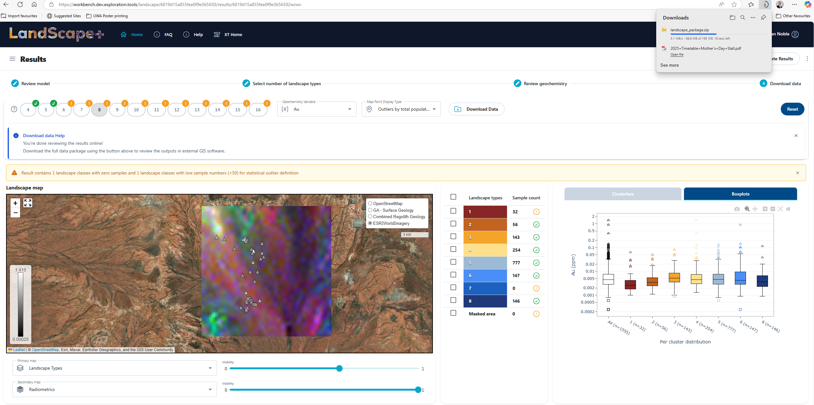

Slide 19
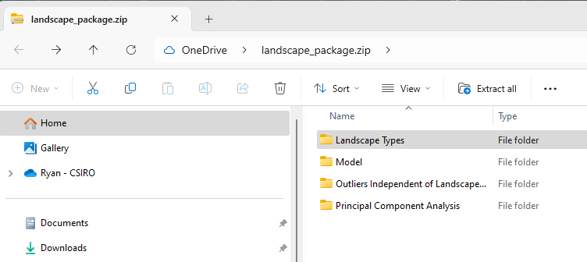
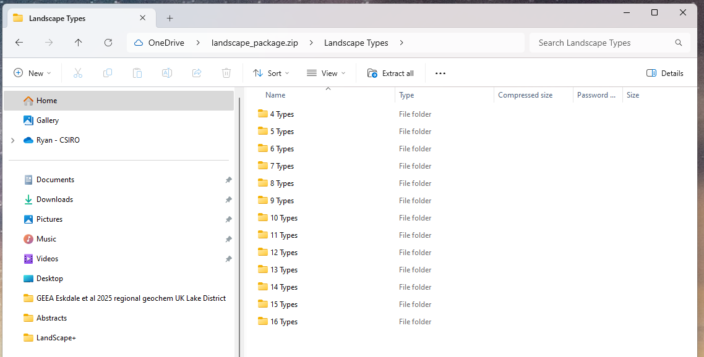
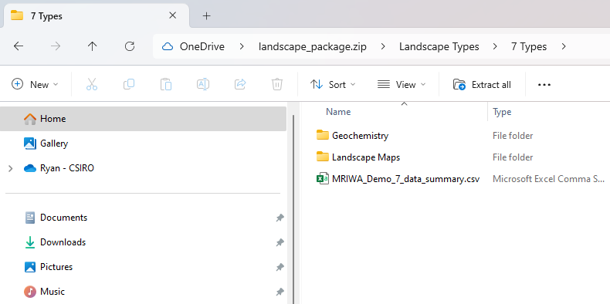

Slide 20




First draft done?...
All the background science and resources
To model landscapes and process results (late-May release)
Notes:
What are the questions that you first looked at and why? Landscape context, soil variation and morphology etc.

Slide 21






Thank you
The UltraFine+® CSRIO Team
Mineral Resources
Ryan Noble
Ryan.Noble@csiro.au
+61 8 6436 8684
Fang Huang
Anicia Henne
John Hillie

Slide 22


Learn more
All the background science and resources
To analyse samples
To model landscapes and process results (late-May release)

Slide 23


